Slide 1
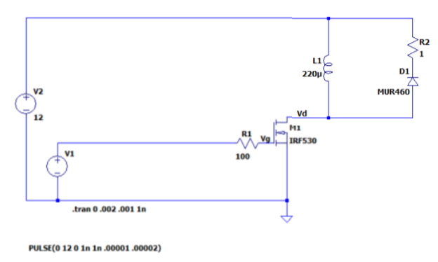
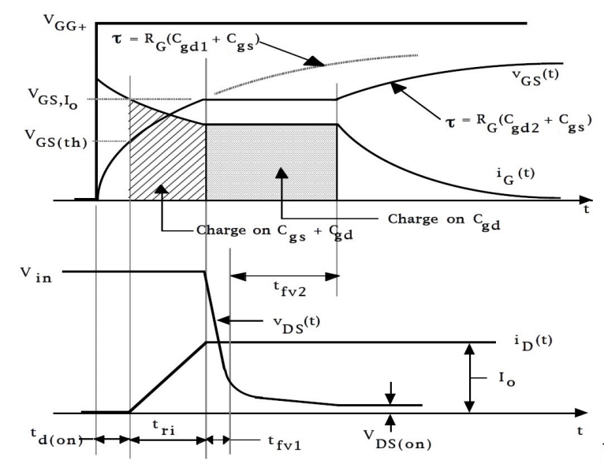
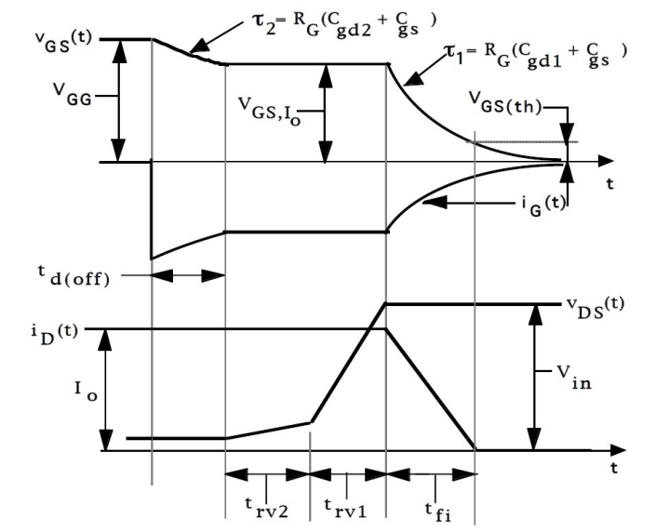


$$ON⇒ t_{dON}, t_{ri}, t_{fv1},t_{fv2}$$
$$OFF⇒ t_{doff}, t_{fi}, t_{rv1},t_{rv2}$$

Slide 2
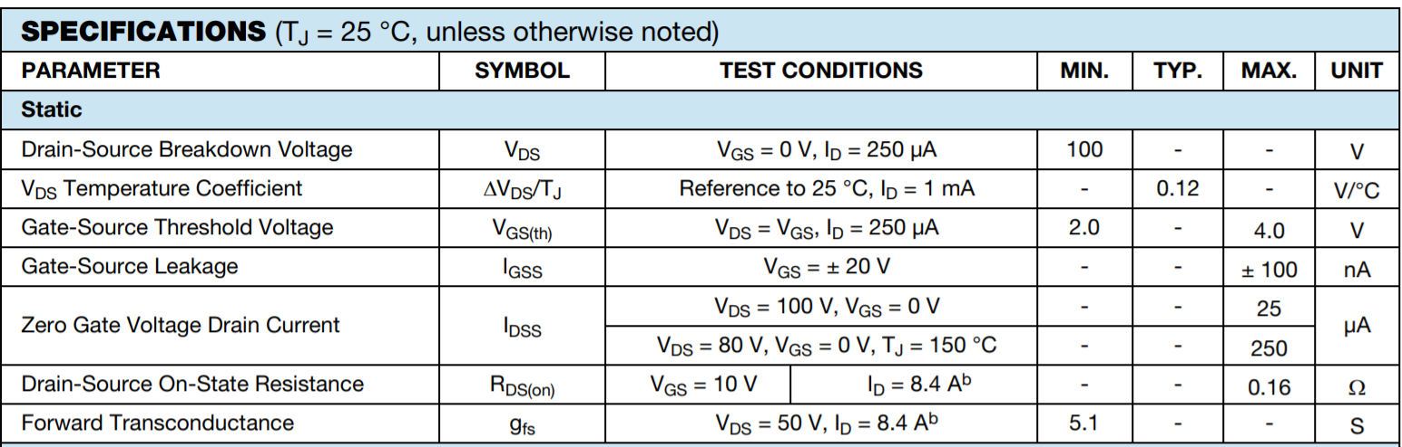



Vgs th =?
Datasheet (https://www.vishay.com/docs/91019/91019.pdf):
$$V_{G{S(th)}_{min}}=2V$$
$$V_{G{S(th)}_{max}}=4V$$
$$⇒V_{GS(th)}=4V$$

Slide 3
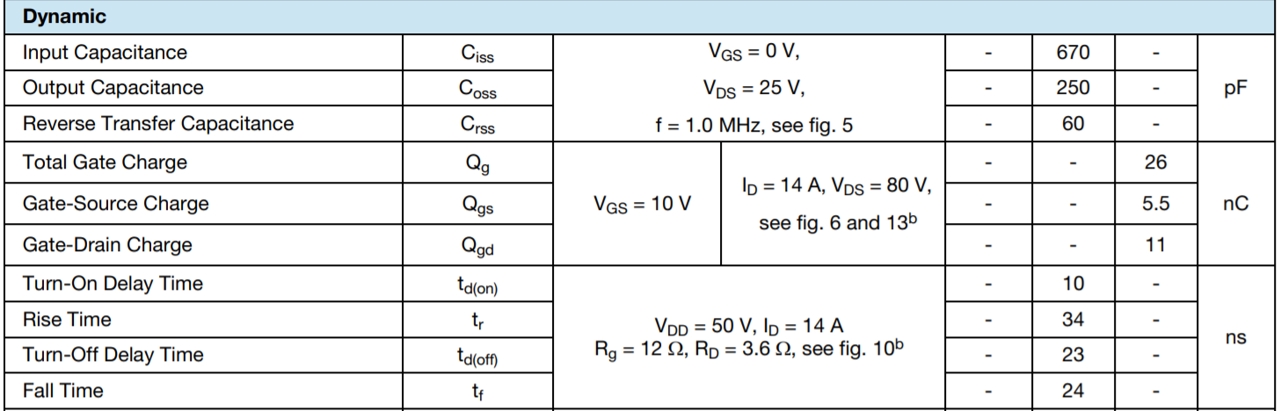
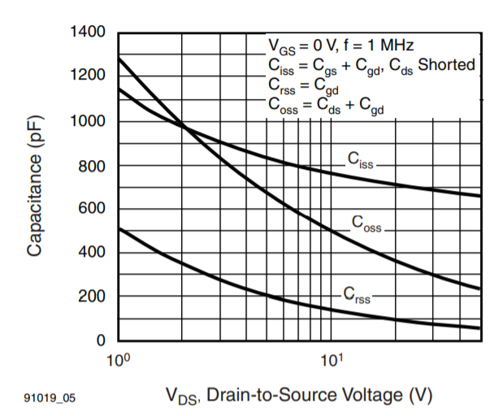
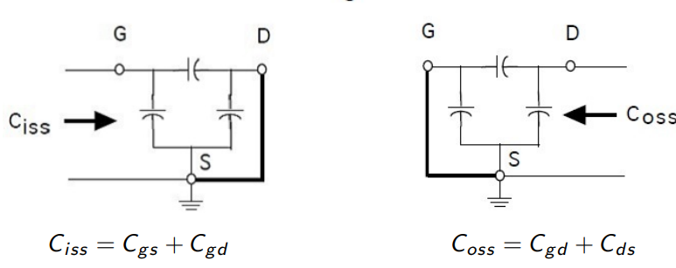
Cosas a tener en cuenta
Datasheet (https://www.vishay.com/docs/91019/91019.pdf):
Vgs = 0 => nos dan Cgd1 (estado OFF).
Ciss = (Cgs + Cgd1) Crss = Cgd1 = 60pf

Slide 4
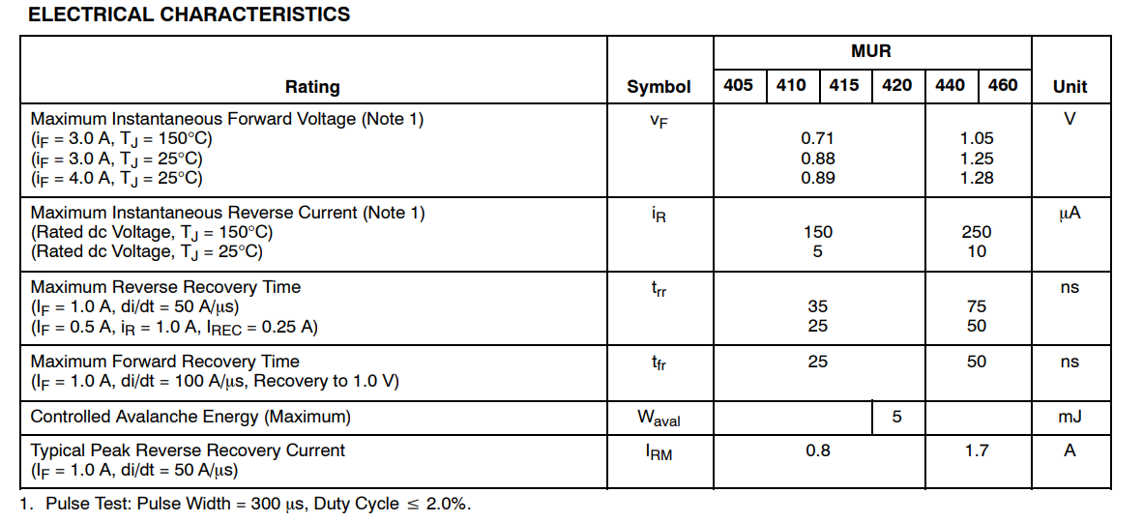

Caracteristicas Diodo MUR460 (https://www.onsemi.com/pdf/datasheet/mur420-d.pdf)
$$Tomo V_{D}=1.3V$$

Slide 5













$$Calculo de la corriente I_{D}$$
$$S=ON$$
$$S=OFF$$
$$R_{2}$$
$$V_{D}$$
$$R_{2}$$
$$R_{2}$$
$$V_{2}$$
$$V_{L}$$
$$V_{2}$$
$$V_{D}$$
$$V_{L}$$
$$V_{L}$$
$$…Habra que tener en cuenta R_{dsON?}$$

Slide 6









$$Hemicircuito S=ON$$
$$V_{2}=i⋅R_{2}+L\frac{di}{dt}$$
$$Homogenea+Particular$$
$$Particular propongo una cte⇒i_{p}=\frac{V_{2}}{R_{2}}, verifica ecuacion$$
$$Homogenea i_{h}⇔i⋅R_{2}+L\frac{di}{dt}=0⇔−\frac{R_{2}}{L}dt=\frac{1}{i}di⇔i_{h}\left(t\right)=i_{a}e^{−\frac{R_{2}}{L}t}$$
$$Sol total⇒i\left(t\right)=\frac{V_{2}}{R_{2}}+i_{a}⋅e^{−\frac{R_{2}}{L}t}$$
$$Normalmente i\left(0\right)=0⇒i_{a}=−\frac{V_{2}}{R_{2}}⇒sol:\frac{V_{2}}{R_{2}}(1−e^{−\frac{R_{2}}{L}t})$$
$$…Habra que tener en cuenta R_{dsON?}$$
$$Condicion para que i(t) sea una lineal$$
$$τ=\frac{L}{R_{2}}=\frac{200μHy}{1Ω}=200μs$$
$$En la simulacion t_{onsw}=10μs$$
$$Sol total⇒i\left(t\right)=\frac{V_{2}}{R_{2}}+i_{a}⋅e^{−\frac{R_{2}}{L}t}$$
$$Cumple que va a ser una lineal!$$
$$\frac{di}{dt}=\frac{{−i}_{a}R_{2}}{L}e^{−\frac{R_{2}}{L}t}$$
$$\frac{di}{dt}=cte⇔t_{onsw}≪τ=\frac{L}{R_{2}}$$
$$Ahora i\left(0\right)≠0 ‼‼Tengo que ver el otro circuito$$

Slide 7
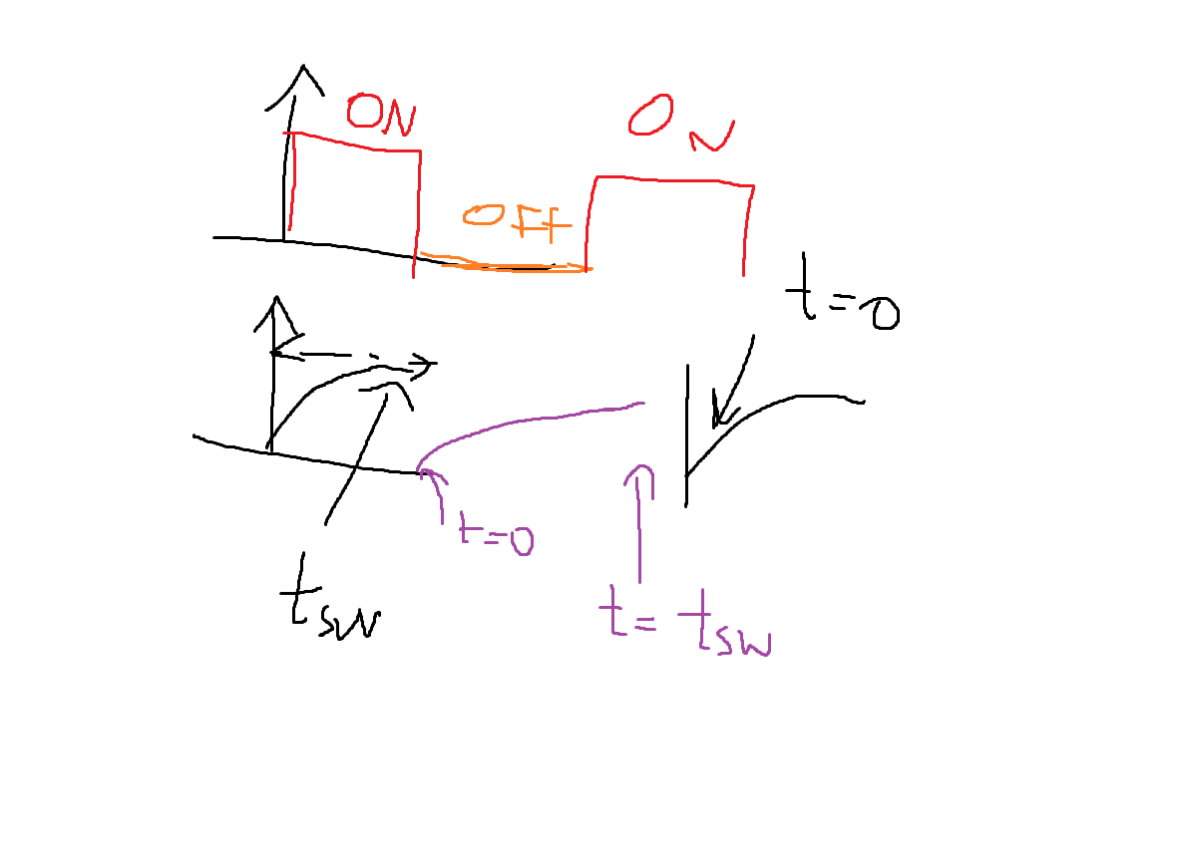









$$Hemicircuito S=OFF$$
$$V_{L} es negativo aca$$
$$V_{L}$$
$$−V_{L}−V_{D}−R⋅i_{L}=0$$
$$−V_{L}−V_{D}−R⋅i_{L}=0$$
$$igualo sw ON a OFF⇒\frac{V_{2}}{R_{2}}+i_{a}⋅e^{−\frac{R_{2}}{L}t_{sw}}=−\frac{V_{D}}{R_{2}}+i_{b}⋅e^{−\frac{R_{2}}{L}0}$$
$$−V_{D}=R⋅i_{L}+V_{L}$$
$$igualo sw OFF a ON⇒\frac{V_{2}}{R_{2}}+i_{a}⋅e^{−\frac{R_{2}}{L}0}=−\frac{V_{D}}{R_{2}}+i_{b}⋅e^{−\frac{R_{2}}{L}t_{sw}}$$
$$Sol total OFF⇒i_{L}\left(t\right)=−\frac{V_{D}}{R_{2}}+i_{b}⋅e^{−\frac{R_{2}}{L}t}$$
$$\frac{V_{2}+V_{D}}{R_{2}}=i_{b}−i_{a}⋅e^{−\frac{R_{2}}{L}t_{sw}}$$
$$Sol total ON⇒i_{L}\left(t\right)=\frac{V_{2}}{R_{2}}+i_{a}⋅e^{−\frac{R_{2}}{L}t}$$
$$\frac{V_{2}+V_{D}}{R_{2}}=i_{b}e^{−\frac{R_{2}}{L}t_{sw}}−i_{a}$$

Slide 8







$$Hemicircuito S=OFF$$
$$V_{L}$$
$$\frac{V_{2}+V_{D}}{R_{2}}=i_{b}−i_{a}⋅e^{−\frac{R_{2}}{L}t_{sw}}$$
$$13.3V=i_{b}−i_{a}⋅e^{−\frac{R_{2}}{L}t_{sw}}$$
$$13.3V=i_{b}−i_{a}⋅0.9512$$
$$\frac{V_{2}+V_{D}}{R_{2}}=i_{b}e^{−\frac{R_{2}}{L}t_{sw}}−i_{a}$$
$$13.3V=i_{b}e^{−\frac{R_{2}}{L}t_{sw}}−i_{a}$$
$$13.3V=0.9512⋅i_{b}−i_{a}$$
$V_{D}=1.3V,t_{sw}=10μs, R_{2}=1Ω, L=200μ{⇒ e}^{−\frac{R_{2}}{L}t_{sw}}$= 0.9512
$$i_{b}=6.81A , i_{a}=−6.81A$$
$$Sol total OFF⇒i_{L}\left(t\right)=−\frac{V_{D}}{R_{2}}+i_{b}⋅e^{−\frac{R_{2}}{L}t}$$
$$Sol total OFF⇒i_{L}\left(0\right)=−1.3+6.81=5.51A$$
$$Sol total OFF⇒i_{L}\left(t_{sw}\right)=5.18A$$
$$Sol total ON⇒i_{L}\left(t\right)=12A−6.81⋅e^{−\frac{R_{2}}{L}t}$$
$$Sol total ON⇒i_{L}\left(0\right)=5.19A en sim 5.12$$
$$Sol total ON⇒i_{L}\left(t_{sw}\right)=5.52A en sim 5.43$$

Slide 9
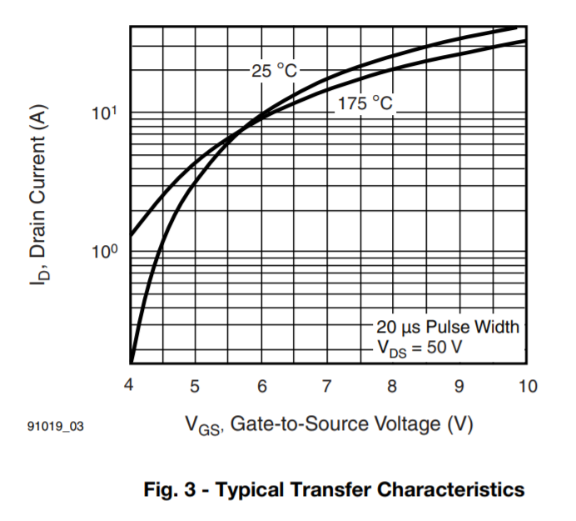
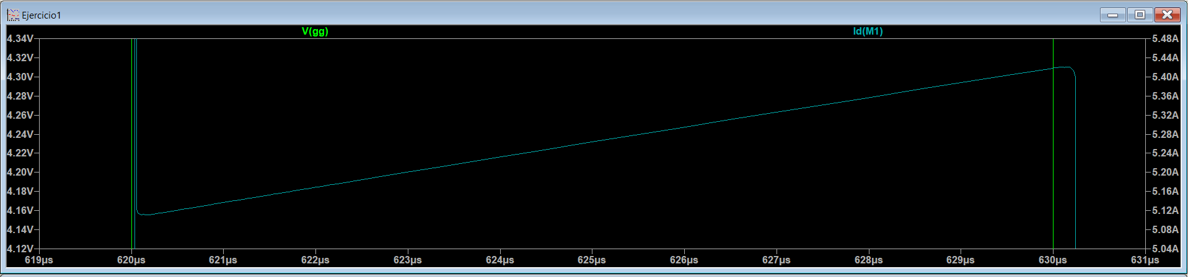







$$I_{D}=i_{min}+\frac{Δi}{2}=5.18A+\frac{5.51−5.18}{2}=5.345A$$
$$Otro criterio posible podria haber sido I_{D}=i_{min}=5.18A, nos va a dar muy parecido de todas formas$$
$$NO:la correinte en el encendido es la imin!Entonces I_{D}=5.18A para el ON y I_{D}=5.51A para el OFF$$
$$Esto nos va a dar dos Vgsio distintas$$
$$Con esto sacamos {V_{GS}}_{IO}$$
$$5.51A$$
$${V_{GS}}_{IO}=5.4V$$
$$5.18A$$
$$5.25V$$
$$5.3V$$

Slide 10






$$Necesitamos determinar V_{DSMAX} que se da cuando pasa de ON a OFF se abre el switch$$
$$Sol total ON⇒i_{L}\left(t\right)=\frac{V_{2}}{R_{2}}+i_{a}⋅e^{−\frac{R_{2}}{L}t}$$
$$Sol total ON⇒V_{L}\left(t\right)=L\frac{di_{L}}{dt}=−i_{a}R_{2}⋅e^{−\frac{R_{2}}{L}t}$$
$Pienso el instante anterior a que cambie a OFF, que seria i_{L} ON en t=tsw$
$$e invierto el sentido de la tension V_{L} que me da en ese instante$$
$$i_{L}$$
$$Evaluo en t=t_{sw} ⇒V_{DSMAX}=V_{2}−(−V_{L}\left(t_{sw}\right))−i_{L}(t_{sw})R_{2}$$
$$⇒i_{L}\left(t_{sw}\right)=5.52A$$
$$⇒V_{L}\left(t_{sw}\right)={−i}_{a}⋅R_{2}e^{−\frac{R_{2}}{L}t_{sw}}=6.477V$$
$$V_{DS_{MAX}}$$
$⇒V_{DSMAX}=12V+6.477−5.51V=12.967V, en sim 13.095V$

Slide 11
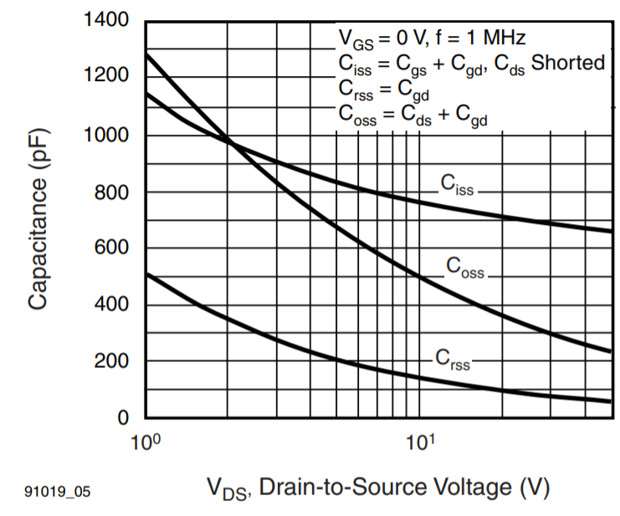
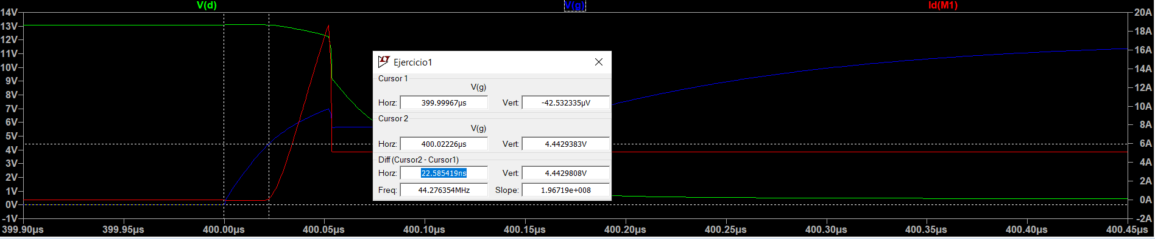

















$$Hay que tener en cuenta la curva de C (V_{DS})$$
$$Calculo {t_{d}}_{ON}$$
$$y que en t_{ON} V_{DS} es V_{DS_{MAX}}=13V$$
$${⇒ C}_{iss}=700pf, Cgd_{1}=70pf$$
$$τ_{1}=R_{G}\left(C_{gd1}+C_{gs}\right)=R_{G}C_{iss}\left(V_{DS}=13V\right)=100Ω⋅700pf=70ns$$
$$V_{GS\left(th\right)}=V_{GG+}\left(1−e^{−\frac{t_{d_{ON}}}{τ_{1}}}\right)$$
$$V_{DS=}$$
$$3V=12 (1−e^{−\frac{t_{d_{ON}}}{70ns}})$$
$$t_{d_{ON}}=20.137ns$$
$$t_{d_{ON}}\left(simulacion\right)=22.58ns$$
$$Ciss_{2}$$
$$t_{d_{ON}}\left(datasheet para otra situacion\right)=10ns, esta en el orden$$
$$1140pf$$
$$700pf$$
$$500pf$$
$$Ciss_{1}$$
$$Cgd_{2}$$
$$Cgd_{1}$$
$$70pf$$
$$V_{DS_{MAX}_}=13V$$

Slide 12
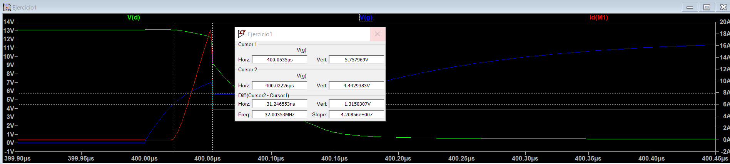







$$Calculo t_{ri}$$
$τ_{d_{ON}}=$ $20.137ns$
$$τ_{1}=R_{G}\left(C_{gd1}+C_{gs}\right)=70ns$$
$$V_{GS_{IO}}=V_{GG+}\left(1−e^{−\frac{t_{d_{ON}}+t_{ri}}{τ_{1}}}\right)$$
$$5.4V=12 (1−e^{−\frac{t_{d_{ON}}+t_{ri}}{70ns}})$$
$$t_{d_{ON}}=19.27ns$$
$$⇒t_{ri}=21.71ns$$
$$t_{ri}\left(simulacion\right)=31.24ns (mido hasta io=cte)$$
$$t_{ri}\left(datasheet\right)=34ns, esta en el orden$$
$$Aca el pico me modifica el grafico…, no tengo precision sobre t_{ri}, asumi que termina cuando se io es cte.$$

Slide 13
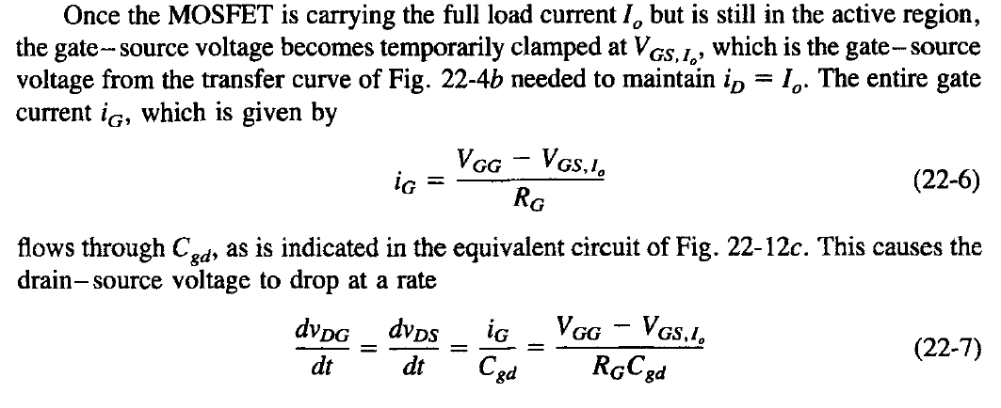
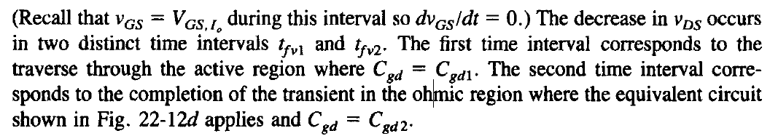
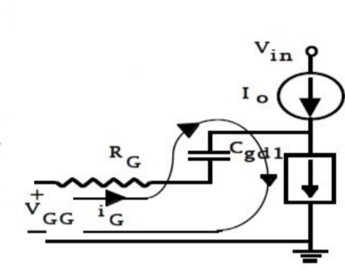
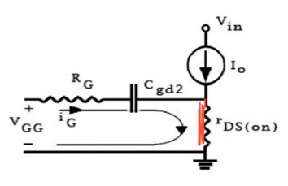





$$Calculo de t_{fv}$$
$$Circuito t_{fv1}$$
$$Circuito t_{fv2}$$
$$Calculo de t_{fv1}$$
$$C_{gd1}=70pf$$
$$y=mx+b⇒v\left(t\right)=−\frac{V_{GG}−V_{GS_{IO}}}{R_{g}C_{gd1}}∗t+V_{DSMAX}=0⇒t_{fv1}=13.78ns$$
$$con esto podemos calcular la potencia$$

Slide 14
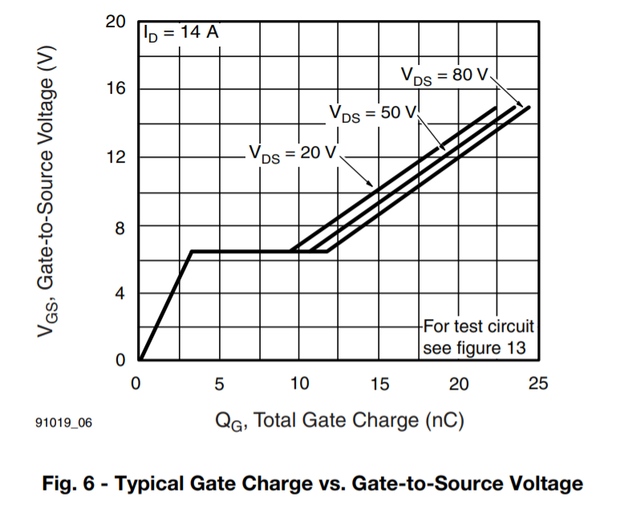

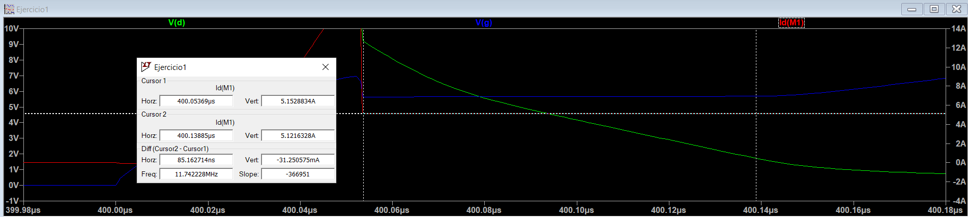






$$Calculo de t_{fv} \left(total\right)⇒sabemos que cuando hay un salto de capacidad, hay un salto de carga.$$
La idea ahora es medir ese salto de carga, que pasa una sola vez en el grafico.
$$Tomo curva V_{DS}=20V aunque la nuestra era V_{DSMAX}=13V$$
$$i_{G} se mantiene constante en la transicion$$
$$=\frac{12V−5.4V}{100}=66mA$$
$$i_{G}=\frac{dq}{dt}⇒ΔQ=(7.5−2.5)nC=5nC$$
$$V_{GS_{IO}}=5.4V$$
$Δt=t_{fv}=\frac{ΔQ}{i_{g}}=\frac{ 5nC}{66mA}=75.75nS$
2.5
7.5
$t_{fv}\left(sim\right)=85.75nS$

Slide 15
$$finalmente si queremos tfv2=tfv−tfv1=85.75nS−13.78ns=71.97ns$$
$$No se como ver tfv1 en la simulacion$$

